Slide 1
SIL Solver Training
SIS-TECH Solutions, LP
We’re Proven-in-Use®

Slide 2
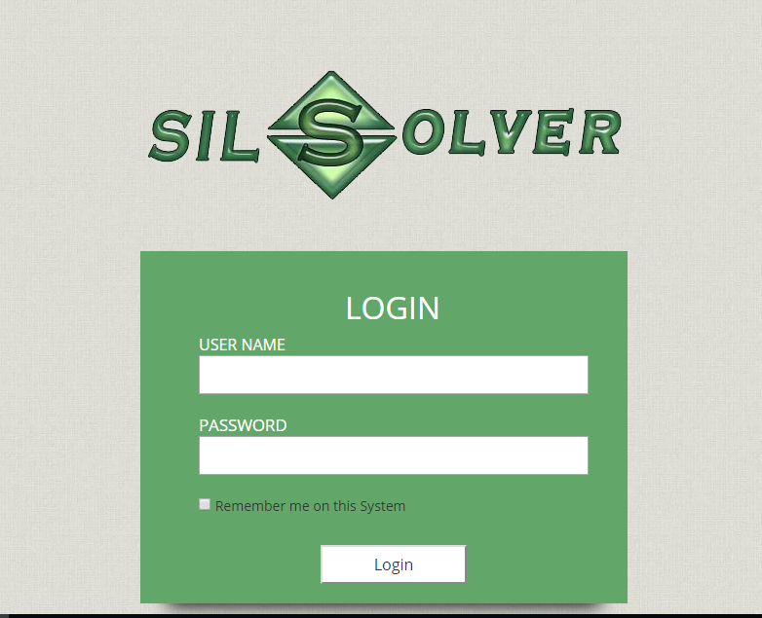
User Name and Password
In any web browser, go to:
http://silsolver.sis-tech2.com/
Log in with your assigned User name and Password

Slide 3
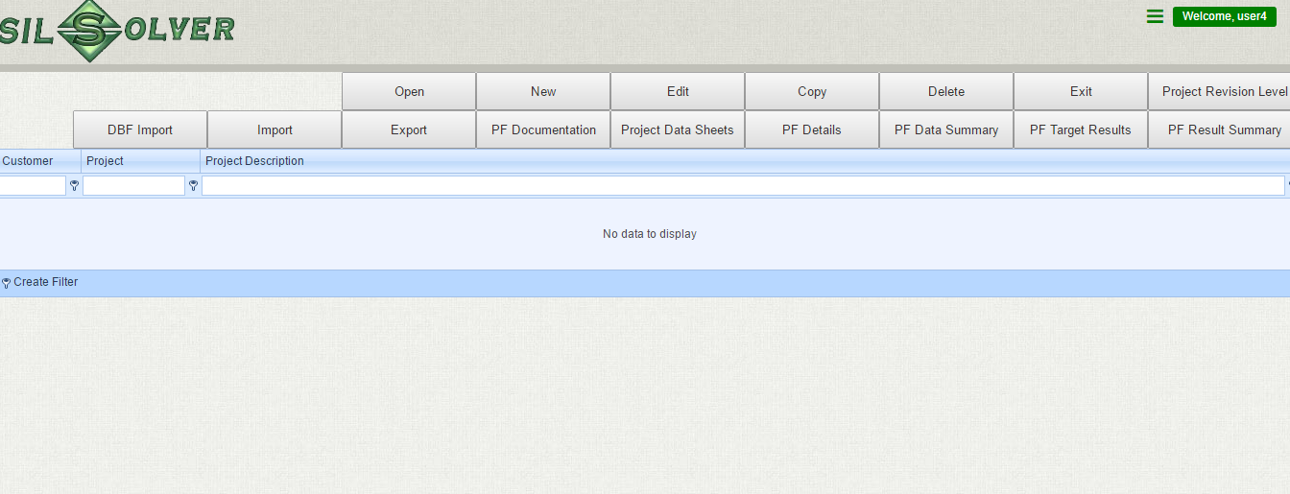
Basic project operation functions
Exit the software
Revision editing
function
Report Generation functions
Used to filter project, Usually not used!!
To perform the functions, a project needs to be selected, otherwise, all operation will be performed on the first project.

Slide 4
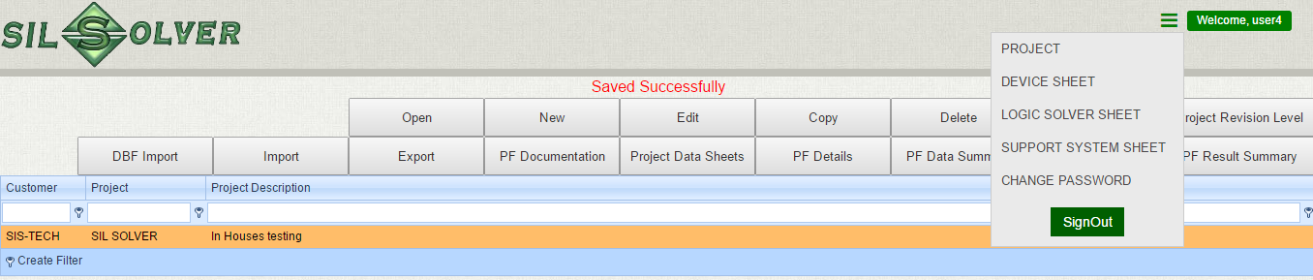
Click to open menu to the data sheets and go back to project main page
Import and export new SIL solver Project files (Zipped file)
Import older SIL solver files (Zipped file)

Slide 5
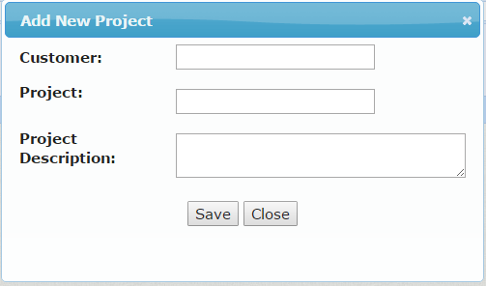
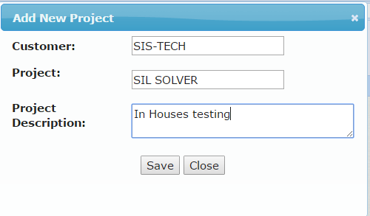
Click to create a new project
The window below pops up, type in relevant information and click “Save”, a project will be created

Slide 6
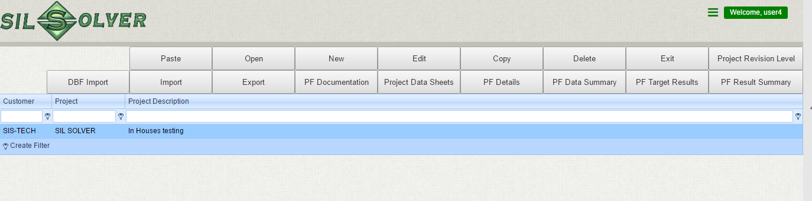
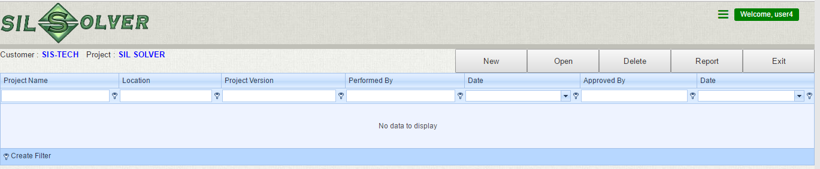
Appear when a project is copied
Select the project
Edit → Edit the designation of the selected project
Delete → Delete the selected project
Copy → Make a copy of the selected project and after that a paste button will appear, when “paste” is click a window will pop up for you to enter new project designation.
Project Revision level→ Go to the project revision editing window below, where you can create/edit/delete a project revision
Basic project operation functions

Slide 7
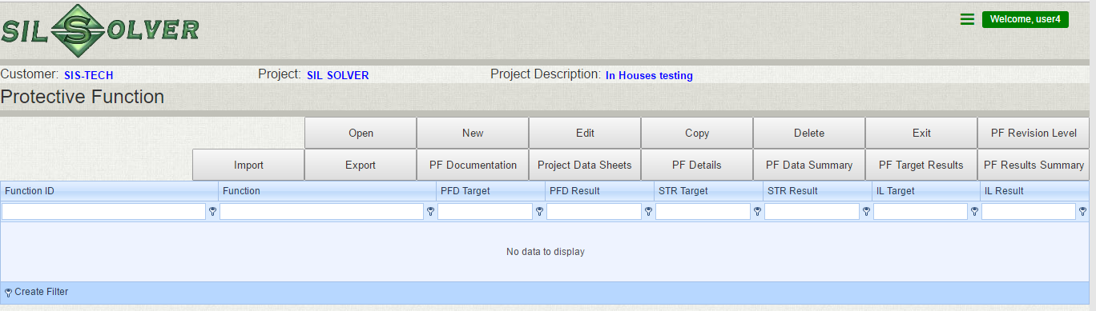
Open A selected project, we will go to the project level with list of Safety functions
The layout is the same as the main project with list of projects except that on the project level, we have the project information listed and NOT have the DBF import function
Project information.

Slide 8
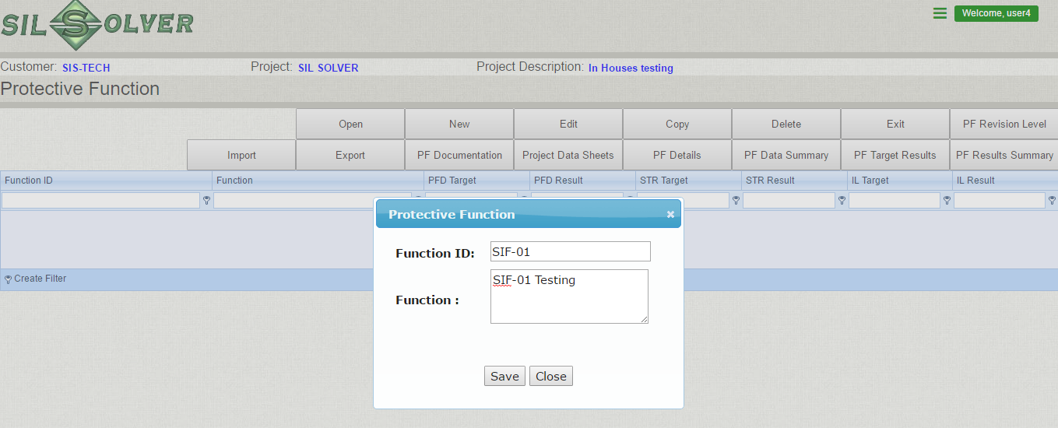
Create a new safety function, by click “New”

Slide 9
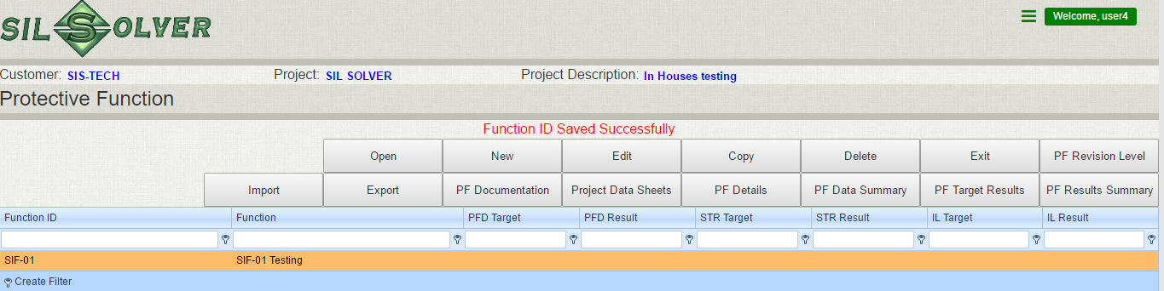
Put in relevant SIF information and click “save”, a new Function is created
SIF related information will be displayed here

Slide 10
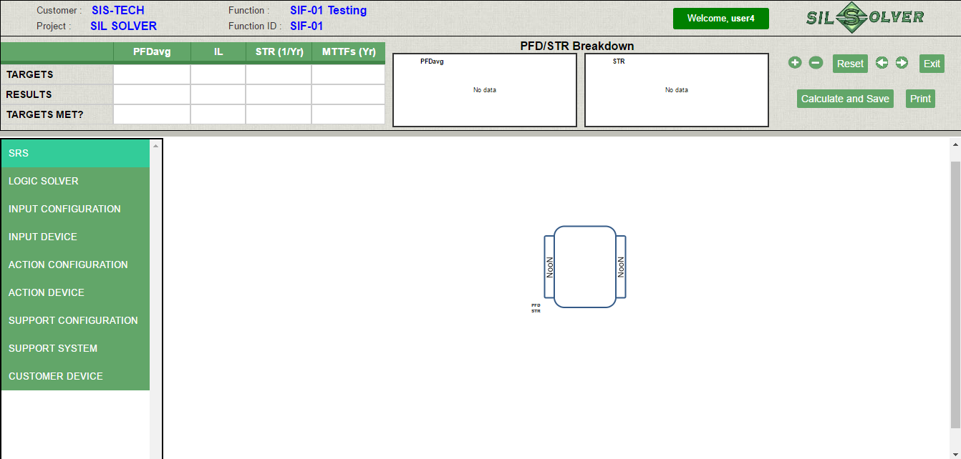
Select the new function and “open” to go to the SIF GUI
SIF calculation results both numerical and graphical
SIF project information
Modelling panel, where you select system configuration and component.
The back and forth and Exit function only works when you have added at least one component in the model!!

Slide 11
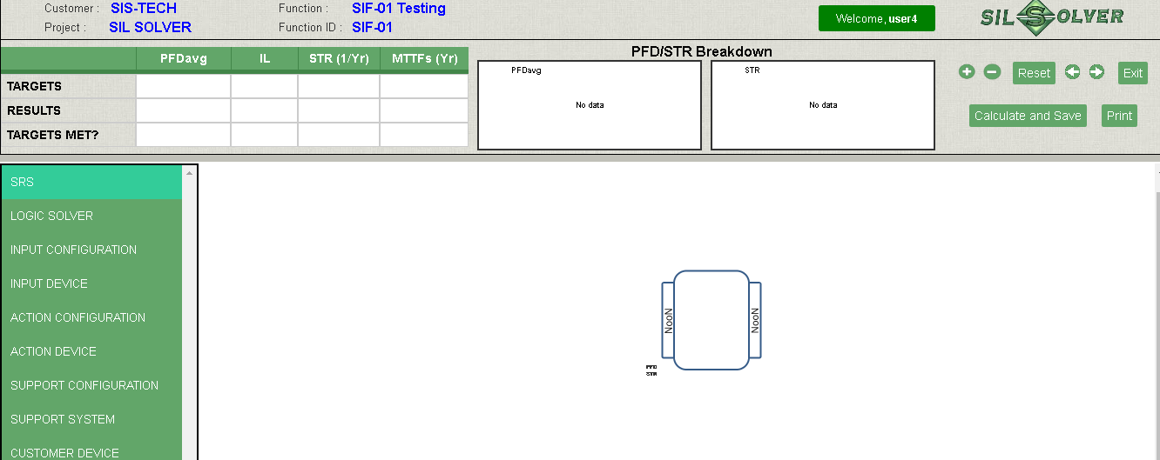
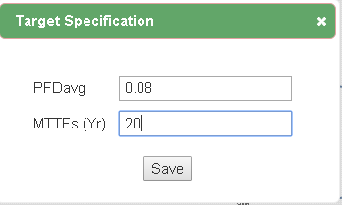
Put in SIL and MTTFs target, click the cell below target, to get to the pop up window.

Slide 12
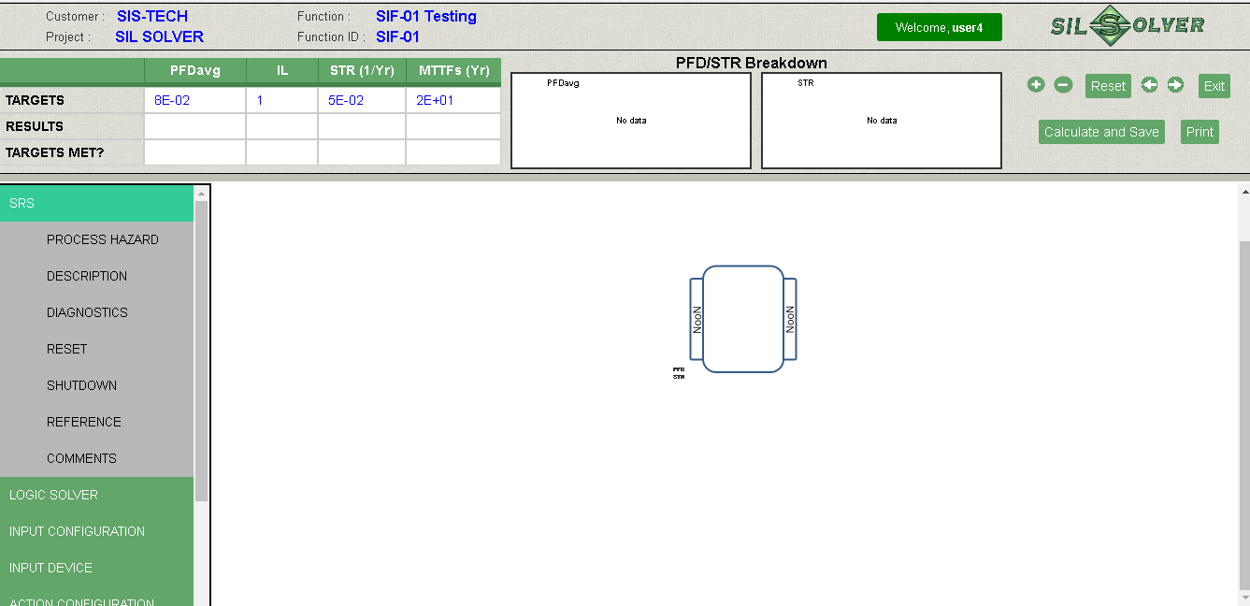
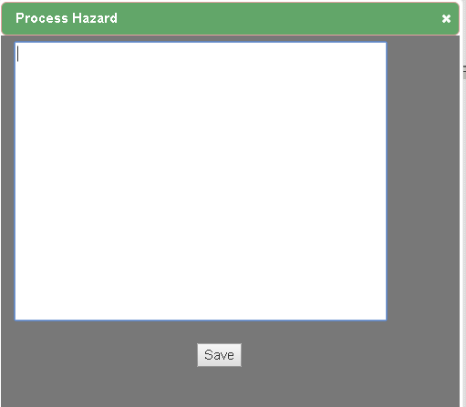
Click the left hand panel to get to the SRS documentation page, where you can put in relevant information

Slide 13
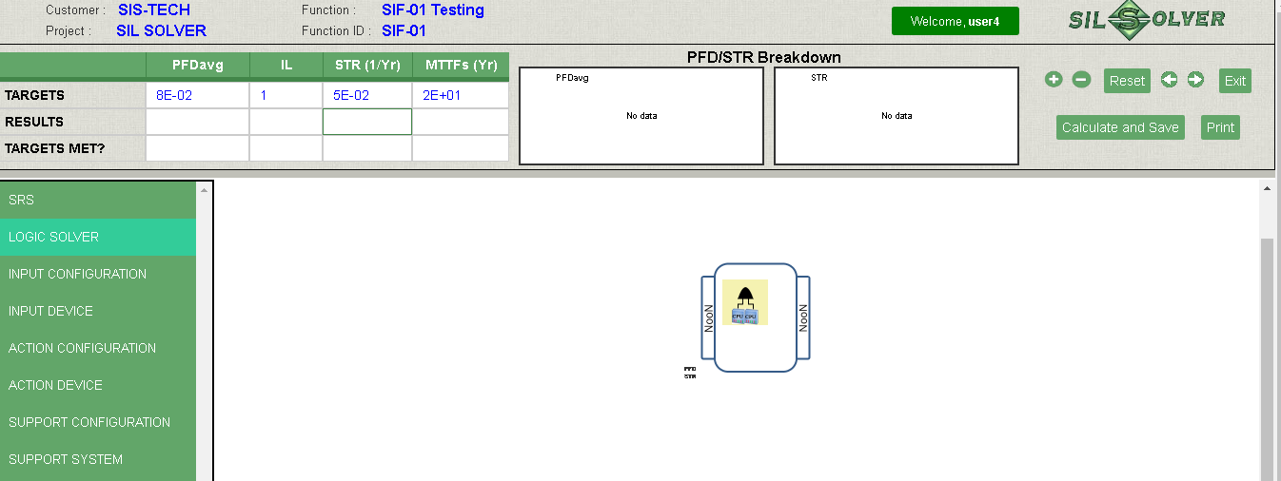
Select logic solver on the panel, a list of logic solver will display, select the desired logic solver and left click to copy and move the mouse to the box in the middle and click to paste.
To delete the logic solver, move the mouse to icon and right click to delete.

Slide 14
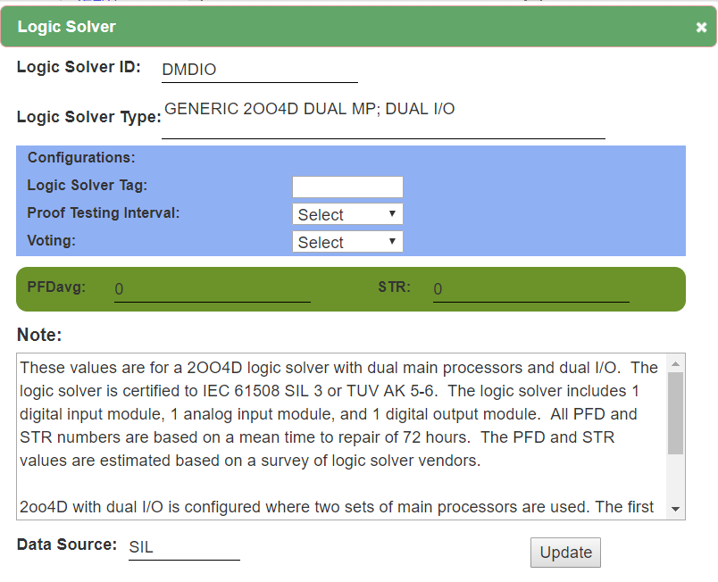
Edit the logic solver parameter by left click the logic solver icon on in the box. Where you can select the voting , TI and assign a tag name.
Note: the voting need to be selected before testing interval.

Slide 15
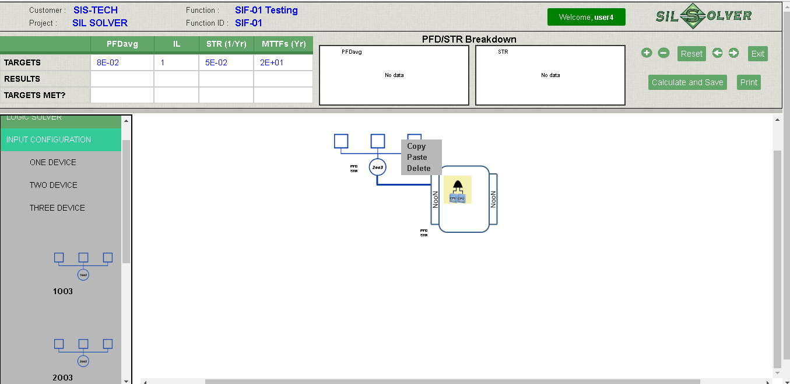
Adding input is divided into two steps, 1) add the input configuration, 2) add each device.
1). Click “input configuration”, a list of device voting will appear, select the desired one and right click, the selected configuration will be added to the GUI .
Right click the configuration, you can copy and delete it.

Slide 16
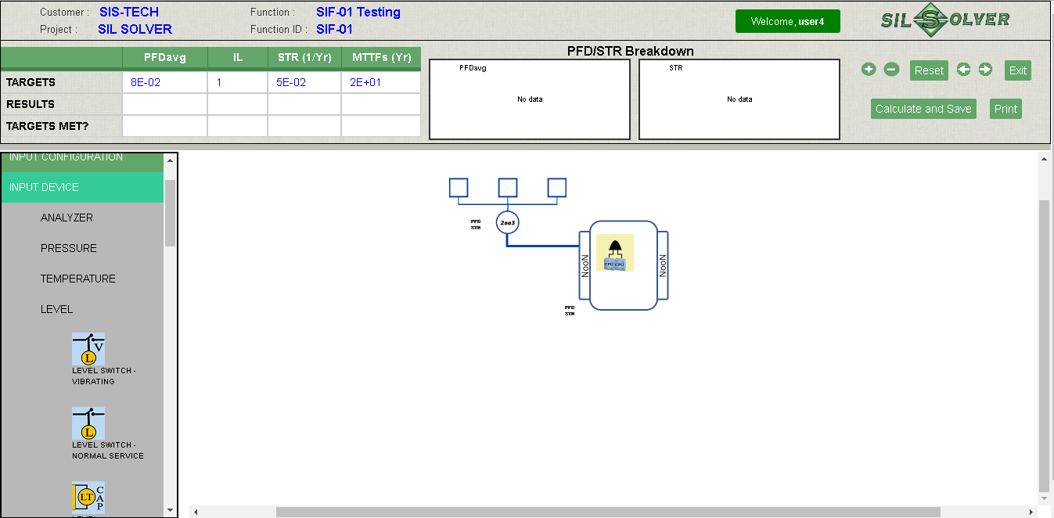
Adding device by click “input device” to access to the list of device categories, and click the relevant category to access the list of devices technology

Slide 17
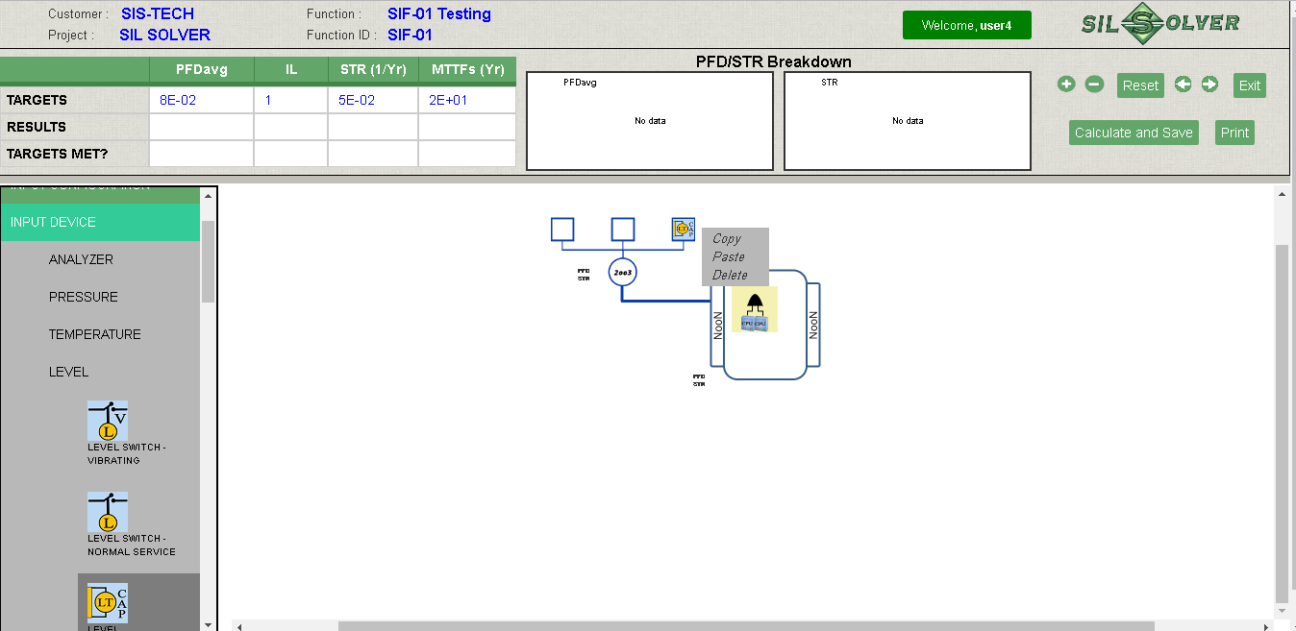
Select the desired device and left click to copy and move the mouse to the box in the input configuration and right click to paste.
To delete or copy the device, move the mouse to icon and right click.

Slide 18
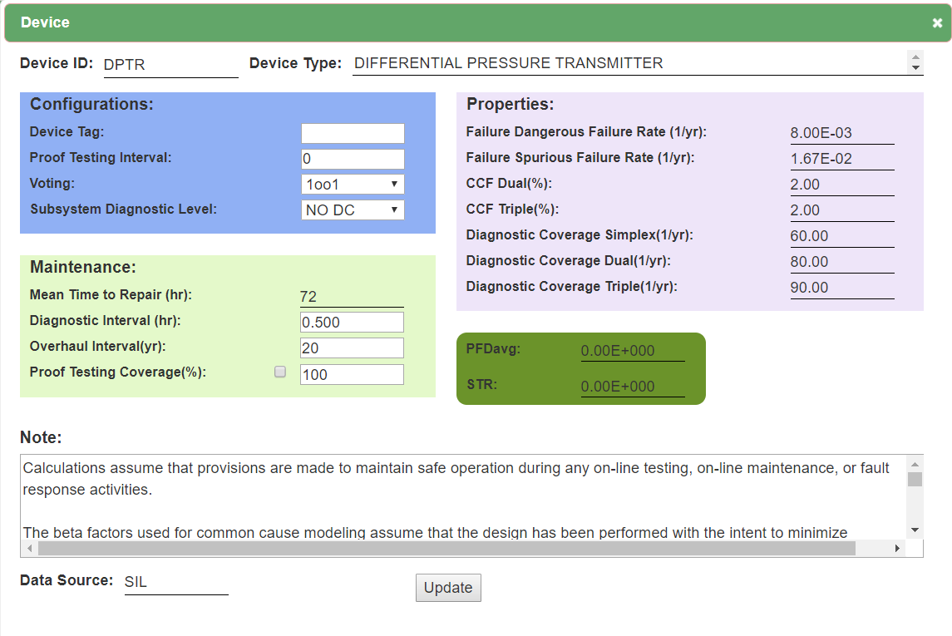
To edit the relevant parameters, left click

Slide 19
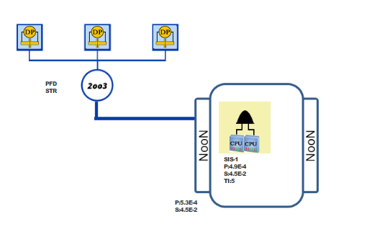
How to model a 2oo3 voting of identical devices (E.g., DP Pressure)?
Select the 2oo3 input configuration
Copy DP Pressure transmitter
Paste DP pressure transmitter to each of box in the 2oo3 input configuration

Slide 20
4. Specify the parameters for each of the DP pressure transmitter by clicking the transmitter icon, select/specify Tag name, Proof test interval, Proof testing coverage, Diagnostic Level, Device level voting (use 1oo1 most of the time!!), Overhaul interval for all three transmitter as below
Define Voting of one device. Use 1oo1 most of the time
Define Diagnostic
NO DC in this case.
Define OI, default is 20Year
Define PTC, default is 100 %

Slide 21
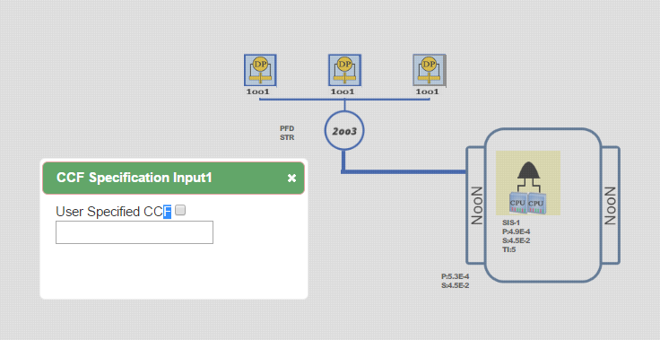
5. Specify CCF factor to by click on the voting 2oo3, insert the CCF fraction, for example, 2% is 2, check the bock before put in value.

Slide 22
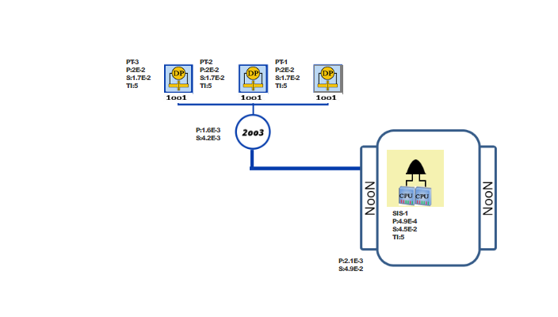
6. Click “calculate and Save”, the PFD and STR of the 2oo3 input will be calculated

Slide 23
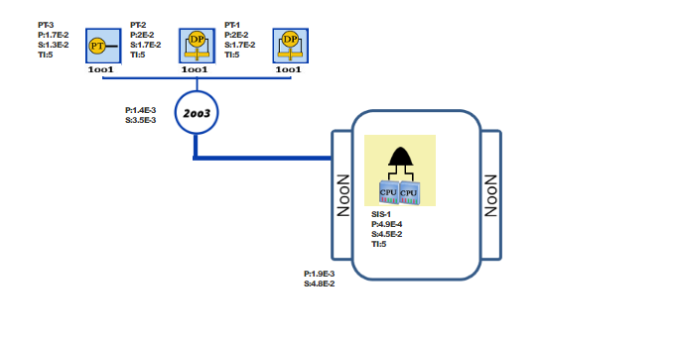
How to model a 2oo3 voting of non-identical devices (E.g.,2 DP Pressure and 1 general PT)?
Select the 2oo3 input configuration
Copy DP Pressure transmitter
Paste DP pressure transmitter to two of the boxes in the 2oo3 input configuration
Copy General Pressure transmitter
Paste General pressure transmitter to the last box in the 2oo3 input configuration
Specify the parameters for each PT and CCF and calculate

Slide 24
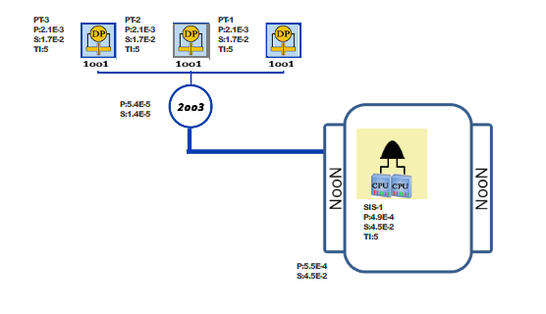
6. Specify the CCF and Click “calculate and Save”, the PFD and STR of the 2oo3D input will be calculated

Slide 25
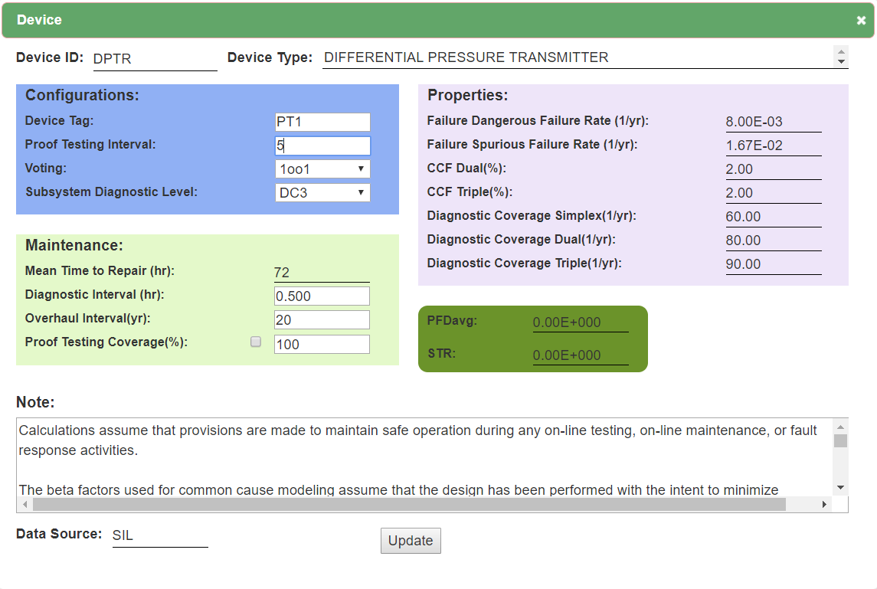
How to model a 2oo3D voting of identical devices (E.g., DP Pressure)?
Select the 2oo3 input configuration
Copy DP Pressure transmitter
Paste DP pressure transmitter to two of the boxes in the 2oo3 input configuration
Specify the parameters for each PT as we did for 2oo3 except changing the Diagnostic level to DC3, such that a diagnostic level for 3 transmitter is applied.
Define Diagnostic
DC3 is used since 3 PTs are used for comparison. The DC used in 90%

Slide 26
5. Specify the CCF and Click “calculate and Save”, the PFD and STR of the 2oo3D input will be calculated

Slide 27
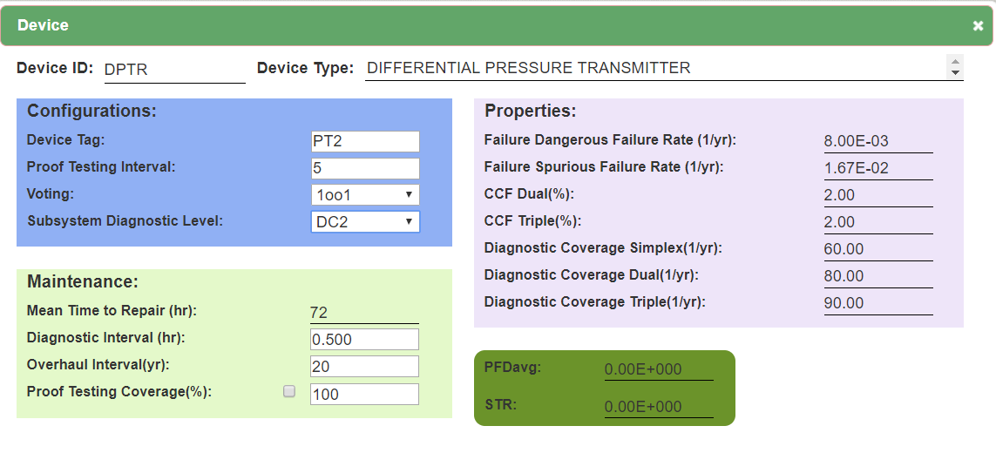
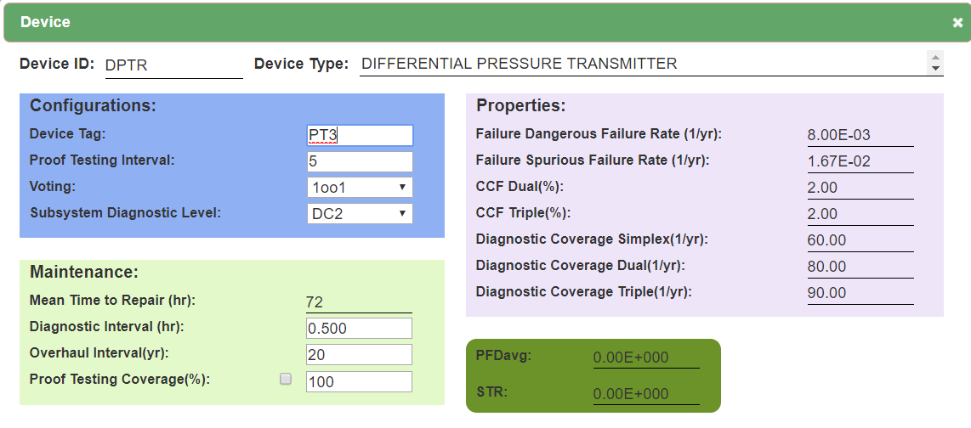

How to model a 2oo3D voting of non-identical devices (E.g.,2 DP Pressure and 1 general PT) (Assuming the DP are comparison and The general PT does not have external Diagnostic)?
Do similar modelling for 2oo3 with non-identical devices
Specify the parameters for each PT as we did for 2oo3 except changing the Diagnostic level to DC2 for the two DP pressure transmitters and keep the General PT Diagnostic level as NO DC.

Slide 28
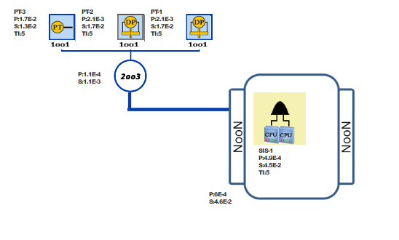
3. Specify the CCF and Click “calculate and Save”, the PFD and STR of the 2oo3D input non-identical devices will be calculated

Slide 29
Similar modeling is applicable for all other input configurations without diagnostic.
For all other input configurations with diagnostic, the general rule for the selection of Diagnostic level is as below,
1oo1D→ DC1 (Diagnostic Coverage Simplex)
1oo2D and 2oo2D→ DC2 (Diagnostic Coverage Dual)
1oo3, 2oo3 and 3oo3D→ DC3(Diagnostic Coverage Triplicated)
HPATD→DC2 (Diagnostic Coverage Simplex)
Exception may exist for case when diverse device are used in the same voting.

Slide 30
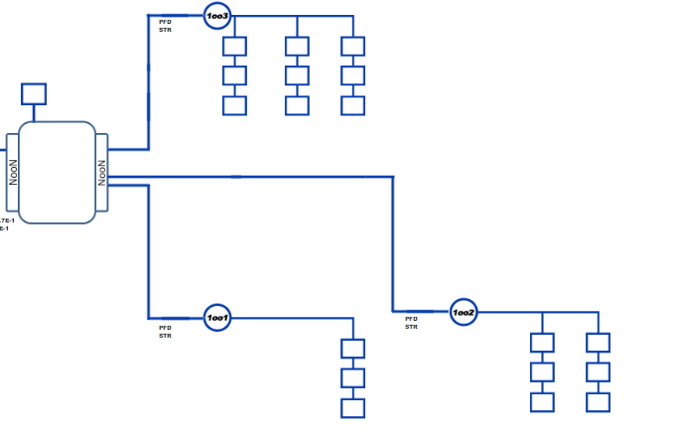
The support system and final actions are modelled in a similar way as the input.
Select the action configuration
Select the action device (Identical logic as SIL solver V 7.0)
Specify relevant parameters

Slide 31
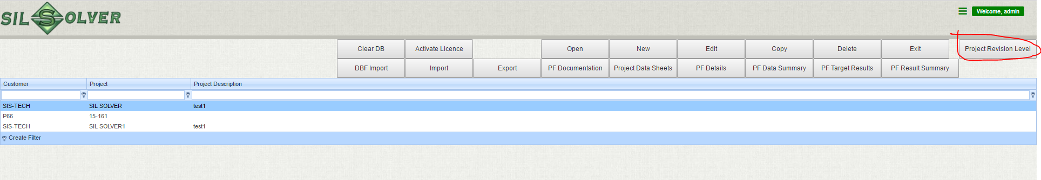
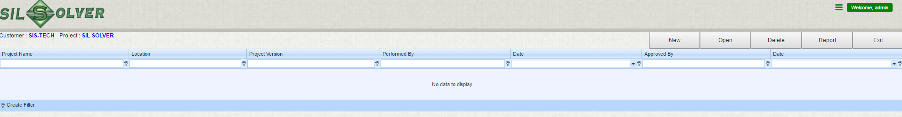
Project Revision Info
To create/edit project revision information, select the project and click “Project Revision level” to get to the editing page, where you can create/edit and delete the project revision information

Slide 32
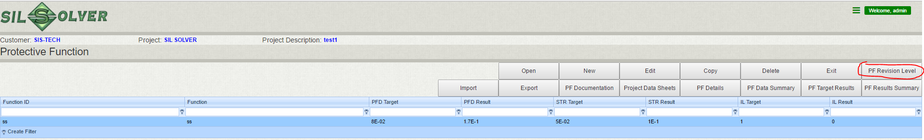
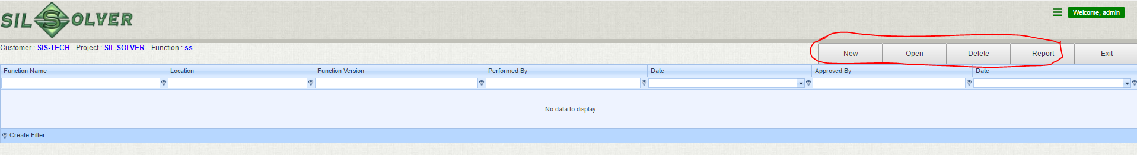
Function Revision Info
To create/edit function revision information, select the function and click “function Revision level” to get to the editing page, where you can create/edit and delete the function revision information

Slide 33
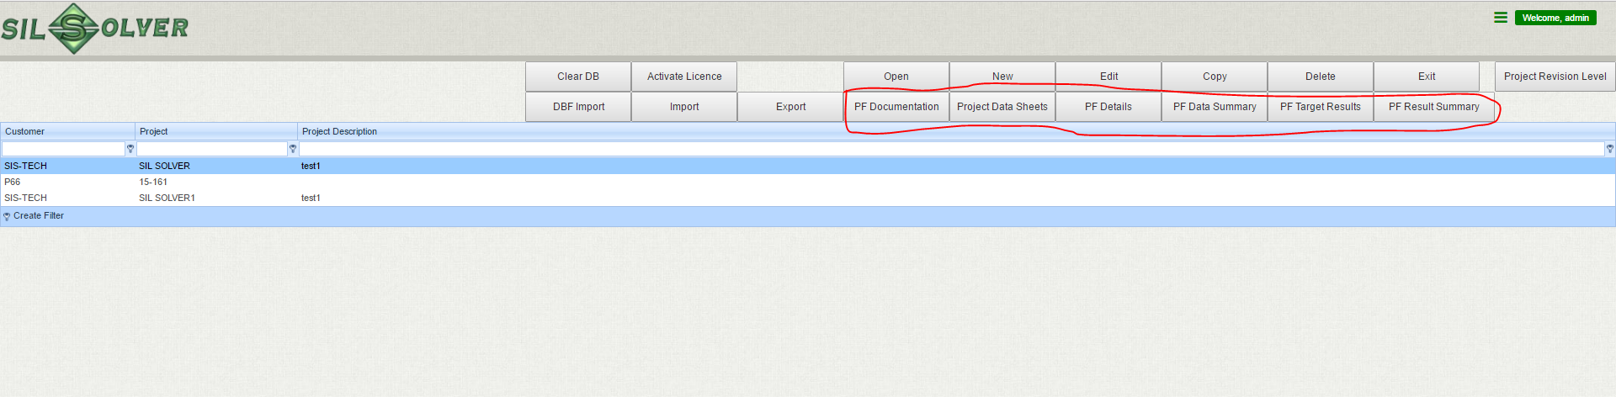
Project Report generation
Print the reports for the whole project by selecting project and click relevant report tab.
When the project reports are printed, the report will include project revision information

Slide 34
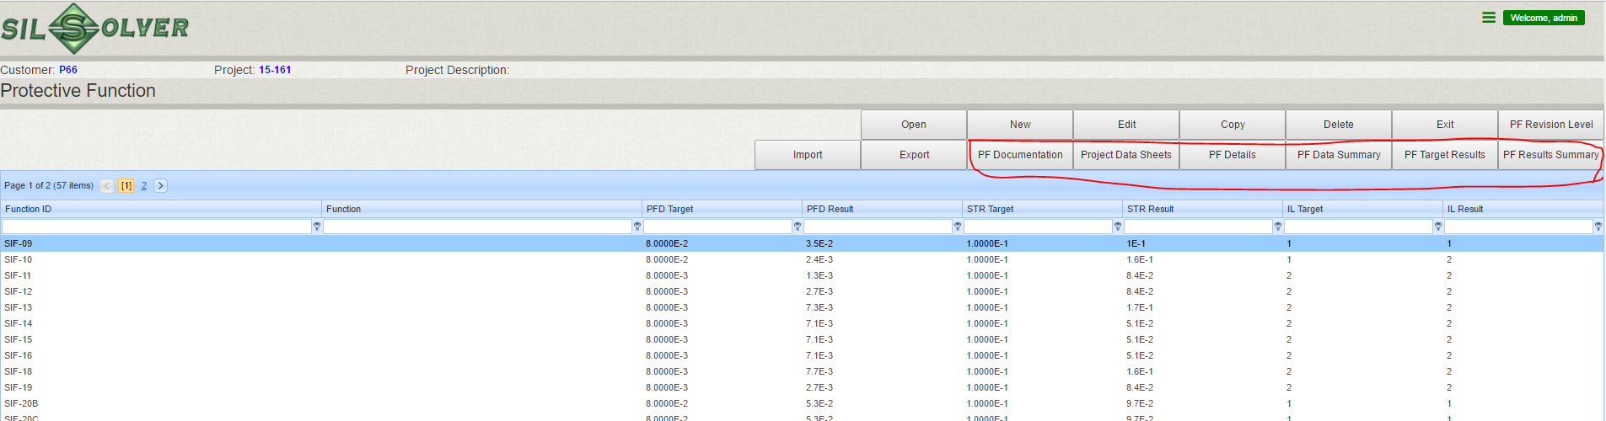
Function Report generation
Print the reports for a function by going to the function list, select a function and click relevant report tab.
When the function level reports are printed, the report will include function revision information

Slide 35


Import and export
The way to share a project/function between users
Project/function zip file
User 2
User 1

Slide 36
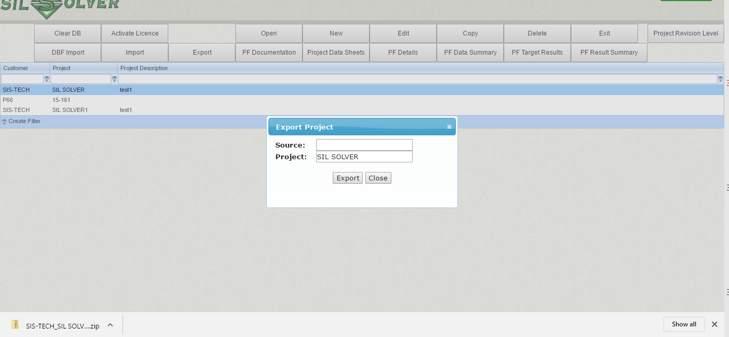
Project export
To export a project:
Go to the project page
Select the project
Click export
A zip file of the project will be created in the download folder

Slide 37
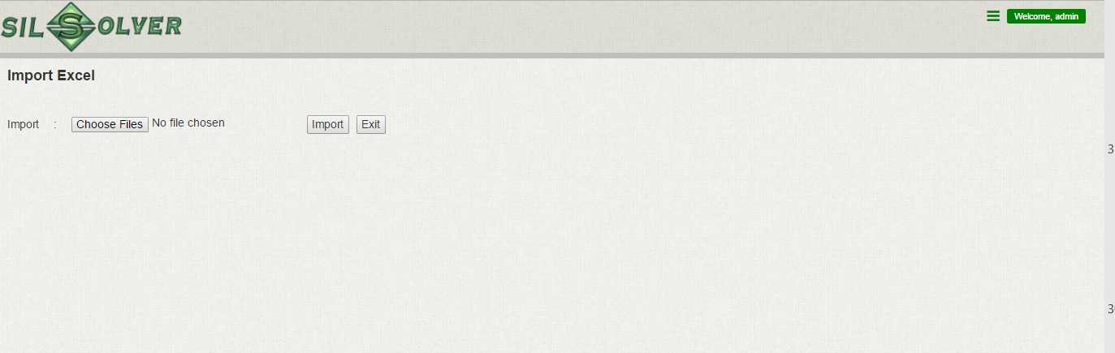
Project import
To import a project:
Go to the project page
Click import, the following project will pop up
Click “choose files”, then changed the directory to the project (zip) file you want to import
The file will be imported

Slide 38
Function export/import
To import a function is the same as for a project, the only difference is that the operations are on the function level page.

Slide 39
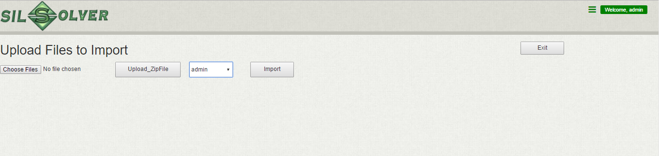
DBF import
To import a project from older SIL solver
  Go to the folder where you saved the project. For example the default directory: C:\SILSolver_Projects
  Zip the project that you want to import to the new SIL solver
  Go to the SIL solver project page
  Click “DBF import” tab, the following page will pop up
  Click “Choose files”, pointing to the Zipped project file
  Click “Upload_zip File”
  When the upload is ready, click import
  A message will pop up when the import is done.

